Slide 1
CSS Demystified
Best Practice Cascading Style Sheets

Slide 2

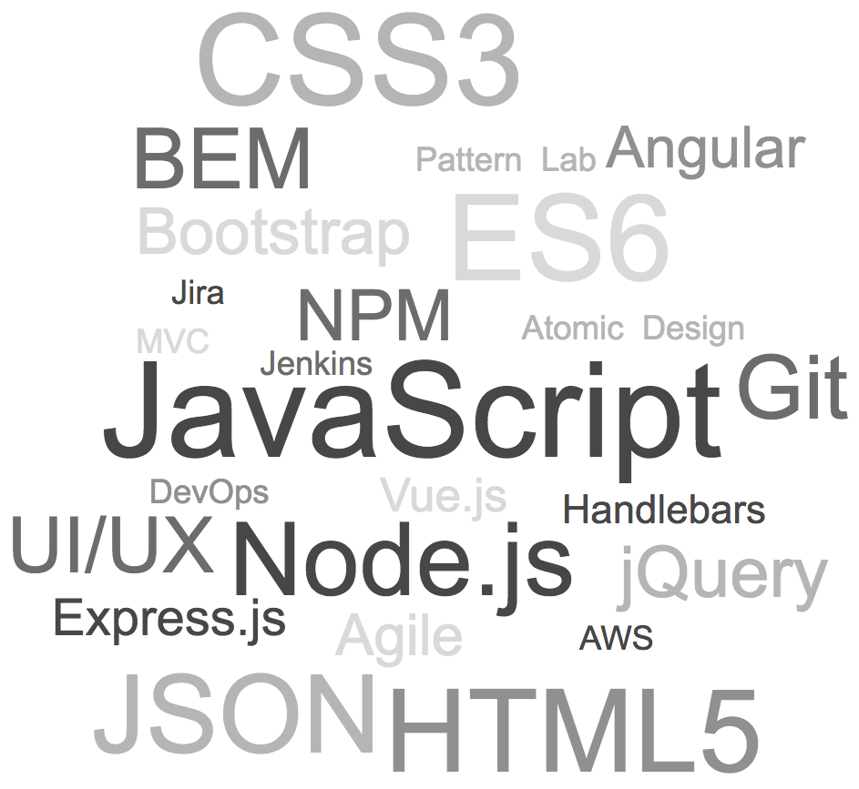
About Mat
Full Stack software engineer
Front End guru
UI/UX specialist
App developer for browsers and devices

Slide 3
Goals
Bug-Free Style Sheets
Extensibility
Rapid Development
Application Performance

Slide 4
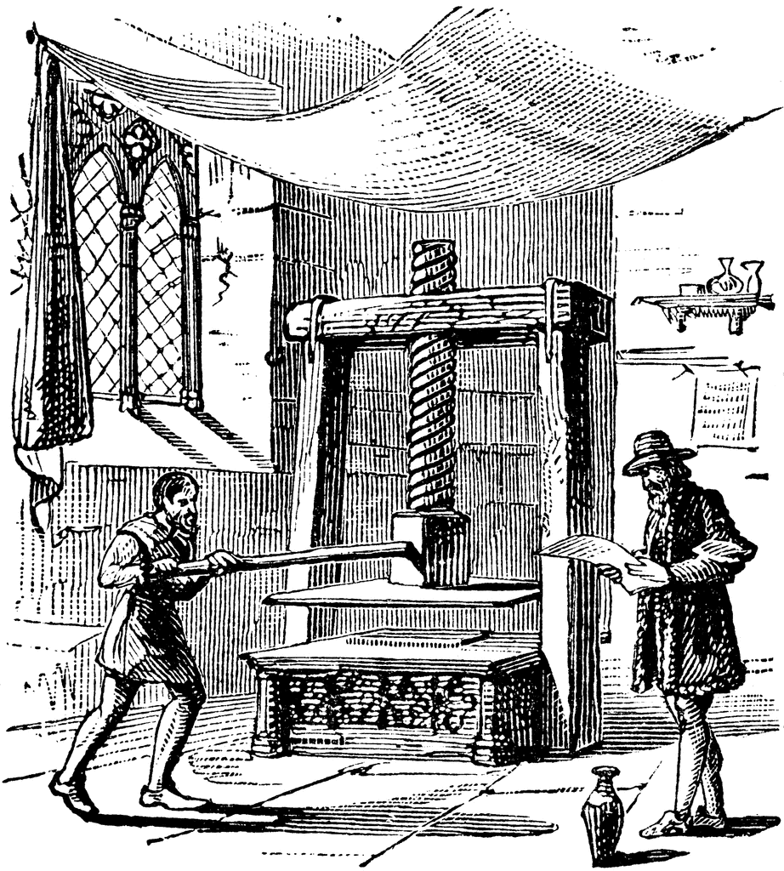

How to Love CSS
Gutenberg bible, 1455
CSS is weird
Based in print
Can be efficient, lightweight, and portable

Slide 5
Start with Semantic HTML
The right tag applies meaning to data
Improves the experience in nontraditional user agents
Enhances styling with default attributes
Optimizes legibility for search engines
Code example

Slide 6
Naming with BEM
Naming is hard! BEM takes the effort out of creating class names
Block-Element-Modifier syntax
Block - standalone entity
Element - nested entity. Name formed with two underscores
Modifier - custom behaviors, appearance, or state. Name formed with two dashes.
Example:
<nav class="nav">
<ul class="nav__list nav__list--active">
<li class="nav__item"></li>
</ul>
</nav>
block | .nav
element | .nav__list
modifier | .nav__list--active

Slide 7
Preprocessor Strategies with LESS and SASS
Preprocessors add power to CSS
Hierarchical syntax
Variables
Enhanced selectors and pseudo-classes
Aggregate values
Logical operators, pattern matching, loops, and more with mixins (“mix in” properties)
Code example

Slide 8
Managing Specificity
The "Cascade" in "Cascading Style Sheets" is how styles inherit and override each other
If two selectors apply to the same element, the one with higher specificity is applied
Best Practice LESS Syntax Example
.nav {}
.nav__wrapper {}
.nav__menu {}
.nav__logo {}
.nav__list {
&--active {
.nav__item {}
}
}
.nav__item {}
.nav__link {}
Compiled CSS for ‘.nav__link’ Child Element
.nav__link {}
Nested LESS Syntax Example
.nav {
.nav__wrapper {}
.nav__menu {}
.nav__logo {}
.nav__list {
&--active {
.nav__item {}
}
.nav__item {}
}
}
Compiled CSS for ‘.nav__link’ Child Element
.nav .nav__list .nav__item .nav__link {}

Slide 9
Mobile First CSS
Reduces specificity
Avoids unnecessary overrides
Less code to manage
Follows mobile browser trends
Compatible with legacy style sheets
Code Examples

Slide 10
Thank You

